Slide 1

Virtual Assistant
KARTHIKEYAN J – 411421106024
EC3711 – Summer Internship
Company Name : TESSOLVE
Duration :3 MONTHS
Date of Presentation : 2.12.2024
Domain : AI/ML

Slide 2
PROGRAMME OUTCOMES (POs)
1. Engineering Knowledge
2. Problem Analysis
3. Design/ Development of Solutions
4. Conduct Investigations of Complex Problems
5. Modern Tool Usage
6. The Engineer and Society
7. Environment and Sustainability
8. Ethics
9. Individual and Team Work
10. Communication
11. Project management and Finance
12. Life-long Learning

Slide 3
PSOs & COs
PROGRAM SPECIFIC OBJECTIVES (PSOs)
Students of the Electronics and Communication Engineering Program 1. Shall have Potential to analyze, design, synthesize and provide technical solutions in the field of VLSI, Embedded Systems, Communication, Networking and Real Time Processing.
Shall exhibit leadership skills and pursue entrepreneurship and contribute in the field of Electronics and Communication Engineering.
COURSE OUTCOMES (COs)
CO1: Industry Practices, Processes, Techniques, technology, automation and other core aspects of software industry.
CO2: Analyze, Design solutions to complex business problems
CO3: Build and deploy solutions for target platform
CO4: Preparation of Technical reports and presentation.

Slide 4
CO-PO-PSO MAPPING
CO | PO1 | PO2 | PO3 | PO4 | PO5 | PO6 | PO7 | PO8 | PO9 | PO10 | PO11 | PO12 | PSO1 | PSO2
CO1 | 3 | 2 | 2 | 2 | 3 | 2 | 2 | 2 | 1 | 1 | 2 | 3 | 1 | 1
CO2 | 2 | 3 | 3 | 2 | 2 | 1 | 2 | 1 | 1 | 1 | 2 | 3 | 1 | 1
CO3 | 2 | 2 | 3 | 2 | 3 | 2 | 2 | 1 | 1 | 1 | 3 | 2 | 1 | 1
CO4 | 1 | 1 | 1 | 2 | 2 | 1 | 1 | 2 | 2 | 3 | 2 | 2 | 1 | 1

Slide 5
ABSTRACT
This project involves creating a virtual assistant named "David" with capabilities such as responding to user commands, providing weather updates, fetching Wikipedia summaries, delivering jokes, reporting current time, playing YouTube videos, sending WhatsApp messages, and answering general knowledge questions.
The assistant supports both text and voice inputs, offering a seamless interaction through a graphical user interface (GUI) built using Tkinter. Additionally, it integrates APIs like OpenWeatherMap, WolframAlpha, Wikipedia, and pyjokes to provide dynamic responses. The application is designed to be user-friendly, leveraging speech recognition for hands-free operation and text-to-speech for voice feedback.

Slide 6
PROBLEM STATEMENT
With the increasing complexity of everyday tasks and information overload, individuals often require a centralized, intelligent system to assist in organizing their activities, answering queries, and providing entertainment.
Current solutions either lack a comprehensive feature set or require significant technical expertise to operate. The need is for an accessible, intelligent assistant that combines various functionalities, including natural language understanding, web APIs, and integration with third-party services, all in a user-friendly interface.

Slide 7
PROBLEM SOLUTION
Command Processing:
Handles various requests such as weather updates, news headlines, and general knowledge answers.
Dynamic Information Retrieval:
Fetches weather details using OpenWeatherMap API.
Retrieves concise Wikipedia summaries for quick answers.
Provides real-time news updates using a News API.
Speech Capabilities:
Uses speech_recognition for recognizing spoken commands.
Responds to both text and voice commands for versatility.

Slide 8
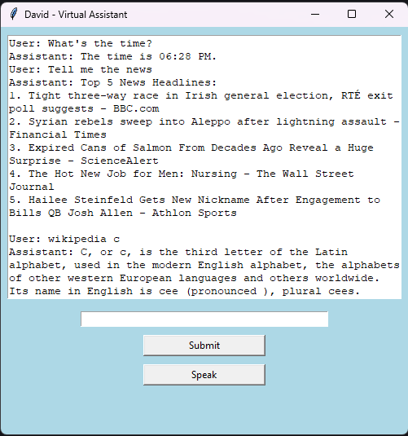






SOLUTION

